Slide 1
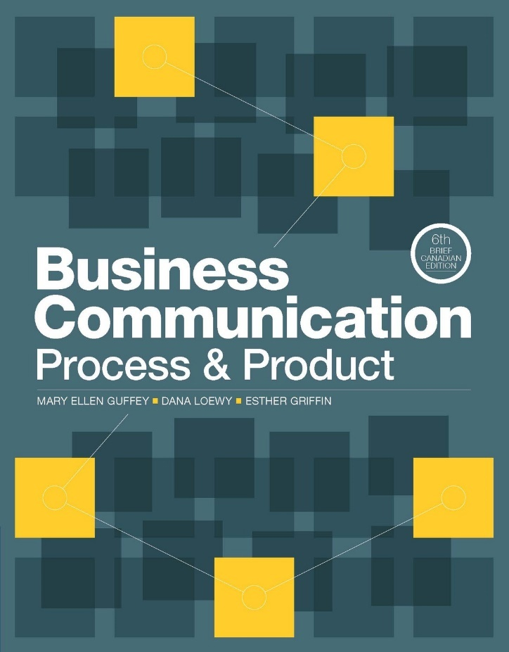
NETA PowerPoint® Slides
to Accompany
Prepared by
Katharine Ferguson,
Seneca College

Slide 2
Interviewing and Following Up
Chapter 16

Slide 3
Interviewing and Following Up
Purposes, sequence, and types of interviews
Before the interview
During the interview
Closing the interview
After the interview
Employment documents

Slide 4
The Purpose, Sequence, and Types of Job Interviews
Potential employees use interviews
To convince the employer of your potential;
To learn about the job and the company; and
To expand on the information in your résumé
www.youtube.com/watch?v=Gww2vrIhjeU
Notes:
From the employer’s perspective, the interview is an opportunity to
Assess your abilities in relation to the requirements of the position
Discuss your training, experience, knowledge, and abilities in more detail
See what drives and motivates you
Decide whether you would fit into the organization
The video demonstrates what not to do in an interview and also what you should do in an interview.

Slide 5
The Purpose, Sequence, and Types of Job Interviews
Employers use interviews
To assess your abilities in relation to the requirements of the position
To discuss your training, experience, knowledge, and abilities in more detail
To see what drives and motivates you
To decide whether you would fit into the organization

Slide 6
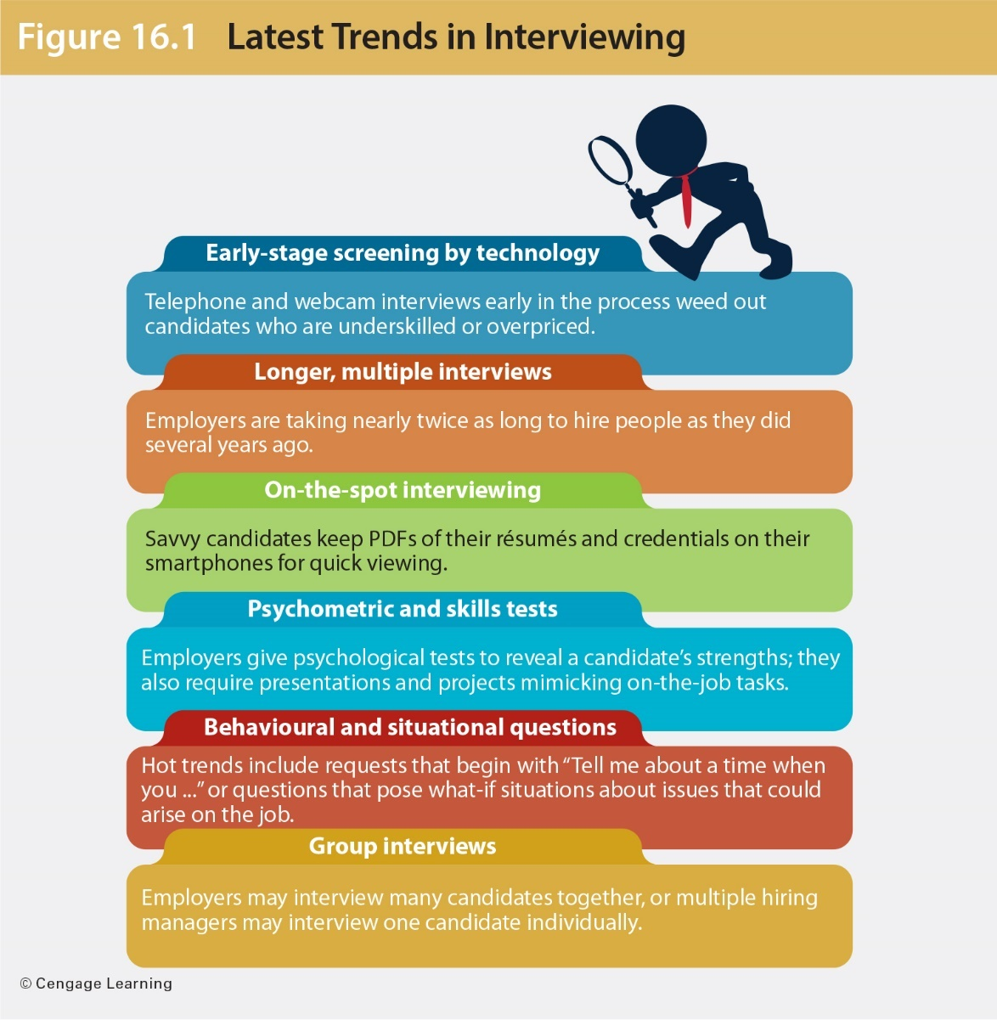
Latest Trends in Interviewing

Slide 7
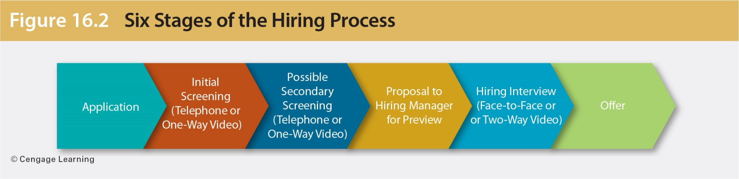
Six Stages of the Hiring Process

Slide 8
Types of Employment Interviews
Screening interviews
Hiring and placement interviews
Panel interviews
Group interviews
Sequential interviews
Video interviews
Notes:
Hiring managers want candidates who are motivated, qualified, and a good fit for the position.
One-on-one interviews: expect to sit down with a company representative and talk about the job and your qualifications.
Panel interviews: they are usually conducted by people who will be your supervisors and colleagues. Interviewers take turns asking questions. These interviews are advantageous because they save time and show you how the staff works together. Keep eye contact with the questioner and with the others. Try to take notes during the interview so that you can remember each person’s questions and what was important to that individual.
Group interviews: these occur when a company interviews several candidates for the same position at the same time. Some employers use this technique to measure leadership skills and communication styles. Stay focused on the interviewer and treat the others candidates with respect.
Sequential interviews: these allow a candidate to meet with two or more interviewers on a one-on-one basis over several hours or days. Don’t assume that any interviewer knows what was said in a previous interview.
Stress interviews: you may be forced to wait a long time before being greeted by the interviewer. You may be given a test with an impossible time limit, be treated rudely by one or more of the interviewers, or have interviewers ask questions at a rapid rate. Remain calm and give carefully considered answers.

Slide 9
Types of Employment Interviews
Screening interviews
Eliminate those who fail to meet minimum requirements
Save time and money by weeding out less-qualified candidates before scheduling face-to-face interviews
Take place on the telephone and sometimes online
Notes:
Screening interviews do just that—they screen candidates to filter out those who fail to meet minimum requirements. Companies use screening interviews to save time and money by eliminating less qualified candidates before scheduling face-to-face interviews. Screening interviews are conducted during job fairs or on campuses. Most screening interviews take place on the telephone, and some take place online.
During screening interviews, be prepared to sell your qualifications.

Slide 10
Types of Employment Interviews
One-on-one interviews
Depending on whether the interviewer is the hiring manager, expect to be asked specific job- related questions or more general questions.
Panel interviews
These are conducted by people who will be your supervisors and colleagues
Try to take notes during the interview to remember questions and the importance of each question to the interviewer.

Slide 11
Types of Employment Interviews
Group interviews
Occur when a company interviews several candidates for the same position at the same time
Often are meant to measure leadership skills and communication styles
Sequential interviews
Meet individually with two or more interviewers one on one over several hours or days
Focus on interviewer and treat other candidates with respect

Slide 12
Types of Employment Interviews
One-way video interviewing
Enables the candidate to respond to a list of scripted questions prepared by the hiring organization.
Benefits employers by cutting the time needed to meet many candidates
Benefits candidates by enabling them to be interviewed at their leisure without travelling to distant locations

Slide 13
Types of Employment Interviews
Two-way video interviewing
Is typically conducted through video chat.
Provides an interactive forum enabling hiring companies to better assess a candidate’s communication skills, body language, and personality.

Slide 14
Preparing for a Video Job Interview
Do your homework.
Plan your answers.
Check your tech.
Look at your lighting.
Control your surroundings.
Dress to impress.
Practise, practise, practise.
Do the best you can.
Notes:
Using the internet, learn all that you can about the target company including its competitors, its products, and its goals.
Be sure you know how your webcam and microphone work so that your audio and video are clear and free of glitches. Position the camera at eye level.

Slide 15
Before the Interview
Ensuring professional phone techniques
Make sure your outgoing answering machine message is concise and professional, without distracting background noise.
Tell those who might answer your phone about your job search and explain the importance of professionalism.
Prevent children from answering the phone.
Don’t answer your cell phone unless you are in a good location to carry on a conversation with an employer.
Use voice mail to screen calls.

Slide 16
Making the First Conversation Impressive
Treat any call from an employer like an interview.
Ask whether you can call back, if you are caught off guard.
Have a copy of your résumé available to answer questions.
Be prepared for a screening interview.

Slide 17
Making the First Conversation Impressive
Take good notes during the phone conversation.
Ask for an interview if given the chance. Try to specify Tuesday at 10:30 a.m. and not Friday end of day.
Confirm the date and time of interview before hanging up.

Slide 18
Researching the Target Company
Learn all you can about the company’s history, mission and goals, size, geographic locations, and number of employees.
Check out its customers, culture, management structure, reputation in the community, competition, financial conditions, strengths and weaknesses, future plans, advertising, and names of leaders.
If possible, interview employees. Consult social media sources.
Notes:
Search potential employer‘s website, news sources, trade journals, and industry directories.
Take time to research the target company; learn about its goals, customers, competitors, reputation, size, history, and so forth. To locate inside information, use social media sources, such as LinkedIn and Twitter. Follow the company on Facebook, and comment shrewdly on the organization’s status updates and other posts. Check out employee review websites. Blogs are good sources for company research. Many employees maintain formal and informal blogs where they share anecdotes and information about their employers.

Slide 19
Rehearsing Success Stories
Prepare success stories as 30-second sound bites.
Study the job description and your résumé. How do your skills and accomplishments fit the position?
Incorporate numbers, dollars saved or percentage sales increased, for example.
Practise answers to typical interview questions. Make your best responses automatic.

Slide 20
Rehearsing Success Stories
Tell success stories about
Dealing with a crisis
Handling a tough interpersonal situation
Successfully juggling many priorities
Changing course to deal with changed circumstances
Learning from a mistake
Working on a team
Going beyond expectations

Slide 21
Cleaning Up Digital Dirt
Remove questionable content.
Stay positive.
Be selective about who is on your list of friends.
Avoid joining groups or fan pages that may be viewed negatively.
Don’t discuss your job search if you are still employed.

Slide 22
Travelling to and Arriving at Your Interview
Give yourself plenty of time to groom and dress.
Arrive at the employer’s office without being rushed.
Arrive at the employer’s office five to ten minutes early.
Don’t smoke or eat anything smelly or messy before the interview.
Avoid too much perfume or cologne.
Be courteous when entering the office.
Greet the interviewer confidently.

Slide 23
Fighting Fear
Practise interviewing as much as you can, particularly with real companies.
Prepare thoroughly.
Understand the process.
Dress professionally.
Breathe deeply.
Know you are not alone.
Remember that an interview is a two-way street.

Slide 24
During the Interview
Sending positive nonverbal messages and acting professionally
Control your body movements.
Exhibit good posture.
Practise appropriate eye contact.
Use gestures effectively.
Smile enough to convey a positive attitude.
Listen attentively.
Notes:
You have already sent nonverbal messages to your interviewer by arriving on time, being courteous, dressing professionally, and greeting the receptionist confidently.

Slide 25
During the Interview
Sending positive nonverbal messages and acting professionally (continued)
Turn off your cell phone or other electronics.
Don’t chew gum.
Sound enthusiastic and interested, but sincere.
Avoid empty words (e.g., um, uh, like).
Be confident but not cocky.

Slide 26
Practising to Answer Interview Questions
Recite answers to typical interview questions in front of a mirror, with a friend, while driving in your car, or in spare moments.
Be sure to pronounce the interviewer’s name correctly.
Avoid answering questions with a simple yes or no.
Keep answers positive.
Don’t criticize anything or anyone.

Slide 27
Practising How to Answer Interview Questions
Refocus to clarify vague questions: “By _____, do you mean _____?”
Aim your answers at the key characteristics interviewers seek: expertise, competence, motivation, interpersonal skills, decision-making skills, and enthusiasm for the company and the job.
Focus on your strengths; do not reveal weaknesses.
Use good English and enunciate clearly.

Slide 28
Questions to Get Acquainted
Tell me about yourself.
What are your greatest strengths?
Do you prefer to work by yourself or with others? Why?
What was your college/university major and why did you choose it?
What are some things you do in your spare time?
Notes:
Recruiters want to know how interested you are in this organization and in this specific position.

Slide 29
Questions to Gauge Your Interest
Why do you want to work for _____?
Why are you interested in this position?
What do you know about our company?
Why do you want to work in the _____ industry?
What interests you about our products [or services]?

Slide 30
Questions About Your Experience and Accomplishments
Why should we hire you when we have applicants with more experience or better credentials?
How do your qualifications and experience prepare you for this position?
Describe the most rewarding experience of your career so far.
How have your education and professional experience prepared you for this position?

Slide 31
Questions About Your Experience and Accomplishments
What were your major accomplishments in each of your past jobs?
What was a typical workday like?
What job functions did you enjoy most? Least? Why?
Tell me about your computer skills?
Who was the toughest boss you ever worked for and why?
Why did you leave or are you leaving your last position?

Slide 32
Questions About the Future
Where do you expect to be five years from now?
Do you plan to continue your education?
What do you predict for the future of the ____ industry?
What would you most like to accomplish if you get this position?
How do you keep current with what is happening in your profession?
Notes:
When asked about the future, show ambition and interest in succeeding with this company.
Strive to convert a discussion of your weaknesses to topics that show your strengths.
Answer challenging questions truthfully, but try to turn the discussion into one that emphasizes your strengths.

Slide 33
Challenging Questions
What is your greatest weakness?
What type of people do you have no patience for?
How would your former supervisor describe you as an employee?
What do you want the most from your job?
Are you currently using illegal drugs?
Who in your life has influenced you the most and why?
What are you reading right now?
Notes:
Additional questions include the following:
Describe your ideal work environment.
Is the customer always right?
How do you define success?

Slide 34
Questions About Salary
What salary are you looking for?
How much are you presently earning?
How much do you think you are worth?
How much money do you expect to earn within the next ten years?
Are you willing to take a pay cut from your current (or previous) job?

Slide 35
Situational Questions
How would you respond if your fellow team members strongly resisted a proposal you made in a meeting?
What would you do if you knew that your boss gave your team data that was totally wrong?
Your supervisor told you to do something in a certain way, and you think that way is wrong. What would you do?
A colleague has told you in confidence that she suspects another colleague of stealing. What would your actions be?
Notes:
Defer the discussion of salary until later in the interview when you know more about the job and whether it will be offered.
See the websites http://salary.monster.ca and www.wowjobs.ca/salary.aspx.
Questions related to situations help employers test your thought processes and logical thinking. When using situational questions, interviewers describe a hypothetical situation and ask how you would handle it. Employers find that situational and behavioural interview questions give them useful information about job candidates.

Slide 36
Behavioural Questions
Tell me about a time when you solved a difficult problem.
Describe a situation in which you were able to use persuasion to convince someone to see things your way.
Describe a time when you had to analyze information and make a recommendation.
Tell me about a recent situation in which you had to deal with an upset customer or coworker.
Notes:
Instead of traditional interview questions, you may be asked to tell stories. The interviewer might ask, “Describe a time when …” or “Tell me about a time when ...”
When answering behavioural questions, describe only educational and work-related situations or tasks and try to keep them as current as possible.

Slide 37
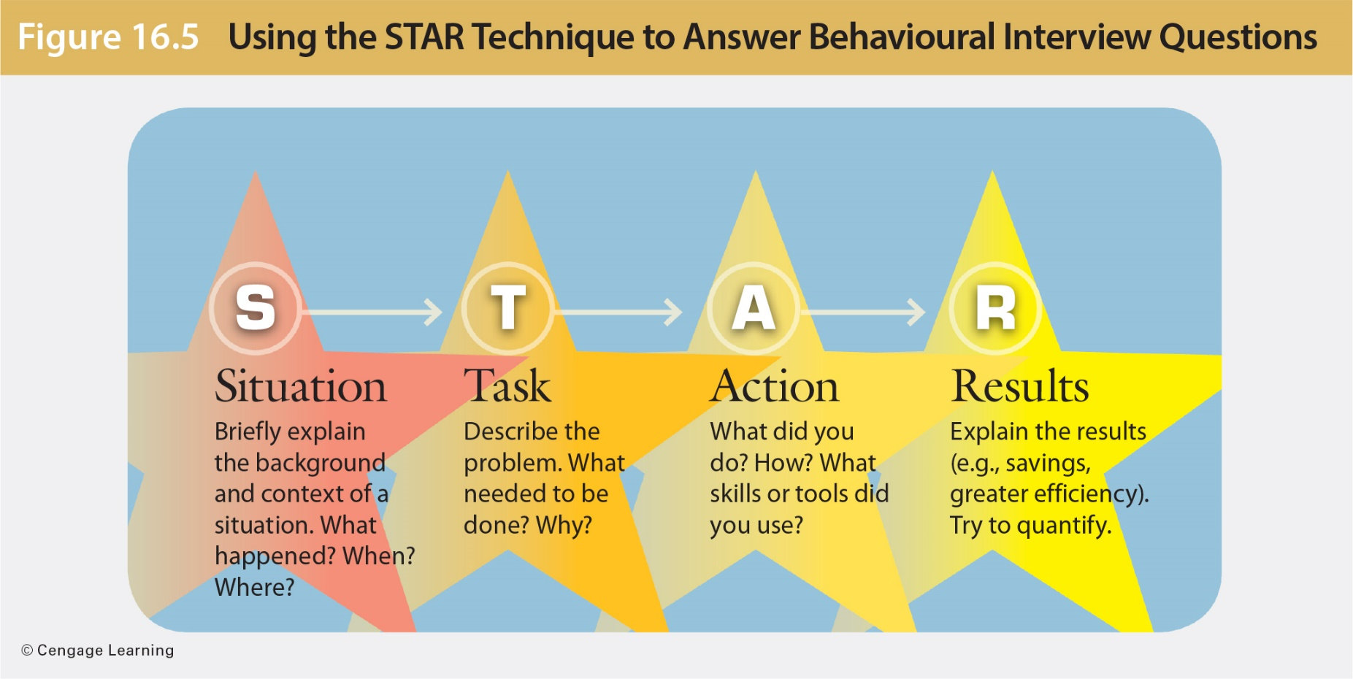
Using the STAR Method to Answer Behavioural Interview Questions

Slide 38
Illegal and Inappropriate Questions
What is your marital status?
Do you have any disabilities?
Where are you from?
Have you ever been injured on the job and filed a workers’ compensation claim?
Have you ever had a drinking or an addiction problem?
Have you ever been arrested?
Notes:
Employment laws that prohibit discrimination in the workplace also apply to interviews. Questions regarding race, national origin, sexual orientation, religion, age, marital status, family situation, arrest record, illnesses or diseases, as well as personal information such as height, weight, or disabilities, are not allowed in an interview. Most illegal interview questions are asked innocently by inexperienced interviewers. Candidates who are asked illegal questions must decide whether to answer, deflect the question tactfully, or confront the interviewer.
You may respond to an inappropriate or illegal question by asking tactfully how it relates to the responsibilities of the position.
Interview questions become illegal only if a court of law determines that the intent was to discriminate.

Slide 39
Illegal and Inappropriate Questions
Are you a Canadian citizen?
How old are you?
Where were you born?
What was your maiden name?
Do you have any religious beliefs that would interfere with weekend work?
Do you have children?
How much do you weigh?
Notes:
Employment laws that prohibit discrimination in the workplace also apply to interviews. Questions regarding race, national origin, sexual orientation, religion, age, marital status, family situation, arrest record, illnesses or diseases, as well as personal information such as height, weight, or disabilities, are not allowed in an interview. Most illegal interview questions are asked innocently by inexperienced interviewers. Candidates who are asked illegal questions must decide whether to answer, deflect the question tactfully, or confront the interviewer.
You may respond to an inappropriate or illegal question by asking tactfully how it relates to the responsibilities of the position.
Interview questions become illegal only if a court of law determines that the intent was to discriminate.

Slide 40
Asking Your Own Questions
What will my duties be?
Tell me what it is like working here in terms of the people, management practices, workloads, expected performance, and rewards.
What training programs does this organization offer?
Who would be my immediate supervisor?
Notes:
The worst thing you can do is to say you have no questions, because it suggests that you are not interested in the position. Instead, ask questions that will help you gain information and will impress the interviewer with your thoughtfulness and interest in the position.

Slide 41
Asking Your Own Questions
What is the organizational structure and where does this position fit in?
Is travel required in this position?
How is job performance evaluated?
What are the major challenges for a person in this position?
What do you like best about working for this organization?
May I have a tour of the facilities?

Slide 42
Ending Positively
Summarize your strongest qualifications.
Show enthusiasm for obtaining this position.
When the interviewer signals the end of the interview, stand up and shake hands.
Ask for a business card and ask to stay in touch through LinkedIn.
Be sure to thank the receptionist.
Notes:
When you end the interview, summarize your strongest qualifications, thank the interviewer, and ask for the interviewer’s card.

Slide 43
After the Interview
Make notes immediately after the interview, as soon as you leave.
Write down the names of people you met.
Alert your references that they might be called.
Write a thank-you letter to the interviewer.
Remind the interviewer of your visit. Show that you really want the job and that you are qualified for it.
If you don’t hear from the interviewer within the specified time, call.
Notes:
A follow-up thank-you letter shows your good manners and your enthusiasm for the job.
Thoughtful candidates alert the people who are acting as references so that they will be prepared to be contacted by the target company. You should have already asked permission to use these individuals as references, and you should have supplied them with a copy of your résumé and information about the types of positions you are seeking.
If you don’t hear from the interviewer within five days, or at the specified time, call him or her. Don’t harass the interviewer and don’t force a decision. If you don’t hear back from an employer within several days after following up, it’s best to assume that you didn’t get the job and to continue with your job search.

Slide 44
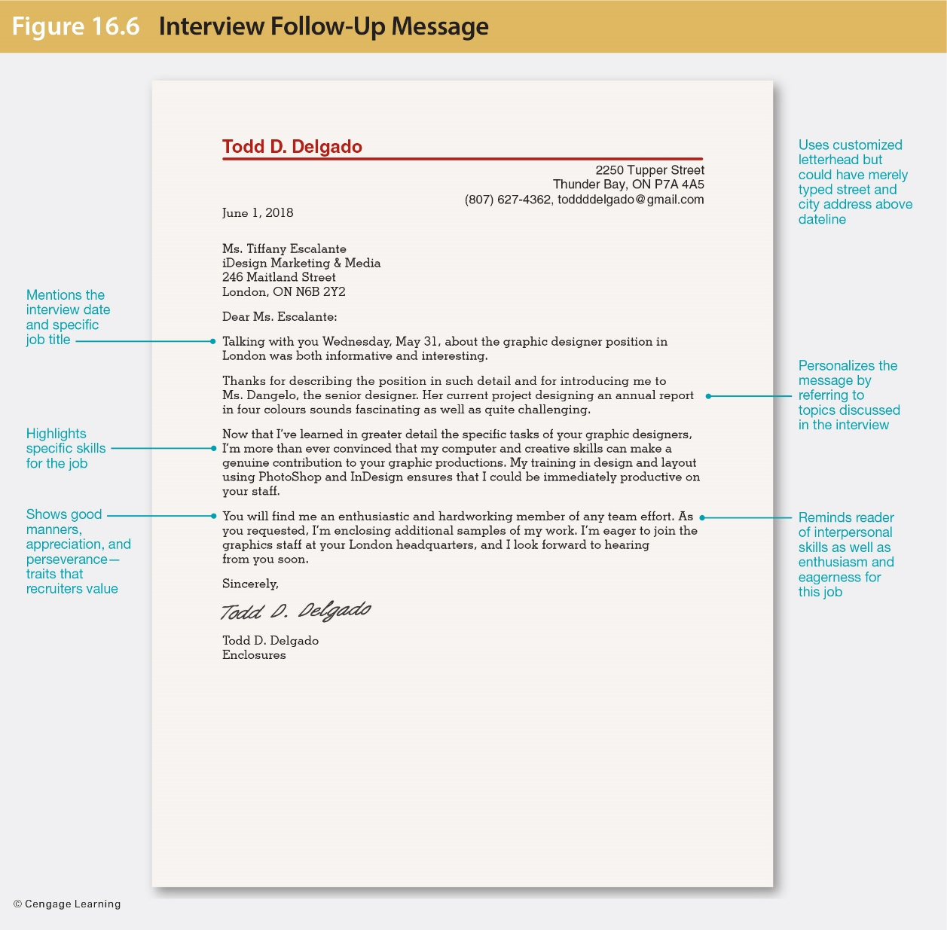
Sending a Thank-You Message

Slide 45
Contacting Your References
Ensure you have asked permission to use references’ names.
Supply them with a copy of your résumé and information about the types of positions you are seeking.
To get letters of recommendation, recommenders need evidence to support generalizations, so give them ammunition.

Slide 46
Following Up
Consider following up if you don’t hear from the interviewer within five days.
Use an e-mail to follow up—it is best and less intrusive.
Sound professional and courteous, not desperate or frustrated.
Don’t harass the interviewer and don’t force a decision.

Slide 47
Preparing Additional Employment Documents
Application form
Be ready with appropriate information for the application.
Review the questions carefully before starting.
Fill out the form neatly.
Answer questions honestly.
Use accurate spelling, grammar, capitalization, and punctuation.
Notes:
In addition to the above, if asked for the position desired, give a specific job title or type of position. Be prepared for the salary question. Be prepared to explain the reasons for leaving previous positions. Look over the application before submitting to make sure it is complete and that you have followed all instructions.

Slide 48
Preparing Additional Employment Documents
Application or résumé follow-up message
Send a short follow-up e-mail or letter to jog the personnel officer’s memory, demonstrate serious interest, and emphasize your qualifications or add new information.
Rejection follow-up message
Respond to rejections as other candidates may decline the position.
Be assured it is acceptable to admit disappointment.

Slide 49
Preparing Additional Employment Documents
Job acceptance and rejection message
Follow up with an acceptance e-mail or letter to confirm details and formalize acceptance
Show professionalism if you must turn down a job offer.
Thank the employer for the job, and explain briefly that you are turning it down.
Resignation letter
Leave your position gracefully and tactfully by writing a formal letter.
Remember that many resignation letters are placed in personnel files.

Slide 50
Summary of Learning Objectives
Explain the purposes, sequence, and types of job interviews
Describe what to do before an interview, including ensuring professional phone techniques, researching the target company, rehearsing success stories, cleaning up digital dirt, and fighting fear.

Slide 51
Summary of Learning Objectives
Describe what to do during an interview, including controlling nonverbal messages and answering typical interview questions.
Describe what you do after an interview, including thanking the interviewer, contacting references, and writing follow-up messages.
Prepare additional employment documents.

